Slide 1
Technical Support (420-1N6-AB) Text, Color and Image Representation
Fall 2023

Slide 2
Byte History
The byte represents the number of bits used to encode one character in a computer and hence it is the smallest addressable unit of memory in several computer architectures.
Size of a byte has been hardware dependent and no definitive standards existed that mandated the size.
A standard was introduced in 1993 that is common now.
1 byte = 8 bits

Slide 3
Representing Text

Slide 4
Problem:
I want to write the following message in terms of 0 and 1:
How would you do it?
Hello World

Slide 5
Text in Computers
In early years, different computer companies applied the binary system in their own way.
The word “cat” would be encoded in binary different on different brands of computers.
This made life difficult in terms of being able to transfer data from one system to another.

Slide 6
ASCII
ASCII (American Standard Code for Information Interchange)
Standard introduced that used a 7 bit code with 128 combinations.
Later became 8-bits (256 combinations) – ASCII-8.
Why eight bits?
So each character can be stored in a single byte.
CAT 0100 0011 0100 0001 0101 0100
cat 0110 0011 0110 0001 0111 0100

Slide 7
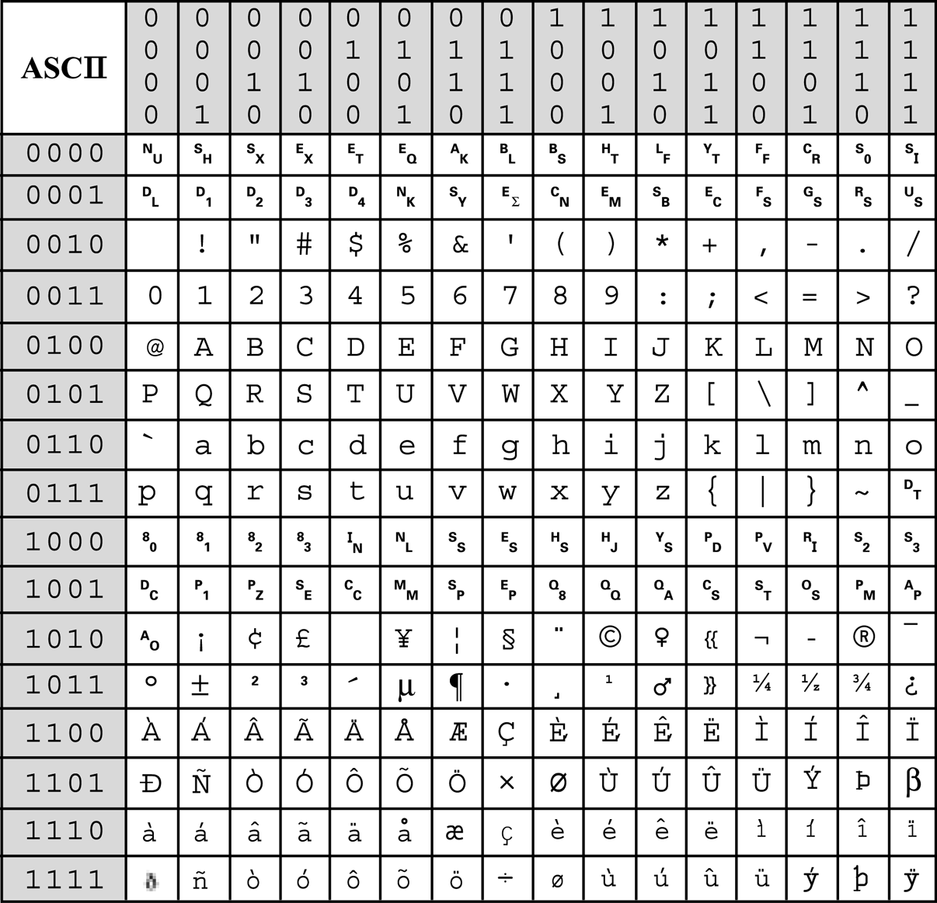
ASCII-8
001
1
Decode the following message
01000001 01010011 01000011 01001001 01001001 00100000 01101001 01110011 00100000 01101100 01101001 01101101 01101001 01110100 01100101 01100100
ASCII is limited

Slide 8
Unicode
Although ASCII works fine for English, many other languages need more than 256 characters, including numbers and punctuation.
Unicode is a computing industry standard for the consistent encoding, representation, and handling of text expressed in most of the world's writing systems and operating systems.
The Unicode standard defines UTF-8, UTF-16, and UTF-32, and several other encodings are in use.

Slide 9
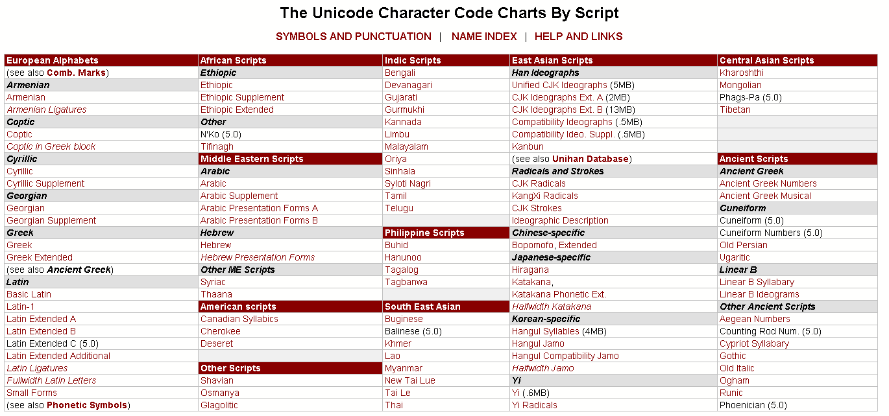
Unicode

Slide 10
Hexadecimal Numbers

Slide 11
Hexadecimal Numbers
Hexadecimal number are base 16 numeric system.
Who uses the hexadecimal system?
Web designers.
Digital medial creators.
Computer scientists.
Networking professionals.

Slide 12
Building Hexadecimal Numbers
Decimal | Hex (16’s column) | Hex (1’s column)
0 | 0 | 0
1 | 0 | 1
2 | 0 | 2
3 | 0 | 3
4 | 0 | 4
5 | 0 | 5
6 | 0 | 6
7 | 0 | 7
8 | 0 | 8
everything is the same so far...

Slide 13
Building Hexadecimal Numbers
Decimal | Hex (16’s column) | Hex (1’s column)
9 | 0 | 9
10 | 0 | A
11 | 0 | B
12 | 0 | C
13 | 0 | D
14 | 0 | E
15 | 0 | F
16 | 1 | 0
17 | 1 | 1
here is where it gets interesting!

Slide 14
Building Hexadecimal Numbers
Decimal | Hex (16’s column) | Hex (1’s column)
18 | 1 | 2
19 | 1 | 3
20 | 1 | 4
21 | 1 | 5
22 | 1 | 6
23 | 1 | 7
24 | 1 | 8
25 | 1 | 9
26 | 1 | A
etc. etc.

Slide 15
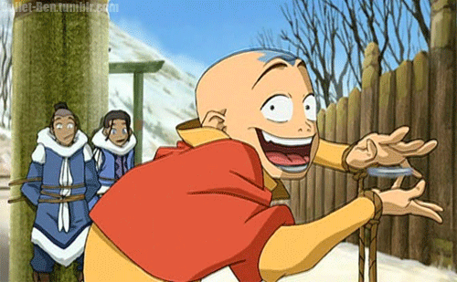
Question
Avatar Aang went to get his first driving license. The clerk asked Aang for his ID to make sure he was old enough to do the driving test. The clerk told him that he needs to be at least 18. Aang answered, “I’m sorry but you are wrong. I am exactly 18. My ID shows my age in Hexadecimal.”
What age is Aang in Hexadecimal?
Hexadecimal 12
Decimal 18

Slide 16
Why Hexadecimal?
Hexadecimal is perfect for matching 4 bits.
Every combination of 4 bits can be matched with one hex number.
(why? think of powers of 2! How many symbols are there in hexadecimal, how many bits do you need to represent one hexadecimal digit?)
4 bits can be represented by 1 Hex value
8 bits can be represented by 2 Hex values

Slide 17
Hexadecimal Digits
Dec Hex Binary
0 0 0000
1 1 0001
2 2 0010
3 3 0011
4 4 0100
5 5 0101
6 6 0110
7 7 0111
Dec Hex Binary
8 8 1000
9 9 1001
10 A 1010
11 B 1011
12 C 1100
13 D 1101
14 E 1110
15 F 1111

Slide 18
What about 8 bits?
Dec. Hex. Binary Dec. Hex. Binary
0 0 0000 8 8 1000
1 1 0001 9 9 1001
2 2 0010 10 A 1010
3 3 0011 11 B 1011
4 4 0100 12 C 1100
5 5 0101 13 D 1101
6 6 0110 14 E 1110
7 7 0111 15 F 1111
-----------------------------------------------------
HEX BINARY
2 4 ?

Slide 19
What about 8 bits?
Dec. Hex. Binary Dec. Hex. Binary
0 0 0000 8 8 1000
1 1 0001 9 9 1001
2 2 0010 10 A 1010
3 3 0011 11 B 1011
4 4 0100 12 C 1100
5 5 0101 13 D 1101
6 6 0110 14 E 1110
7 7 0111 15 F 1111
-----------------------------------------------------
HEX BINARY
2 4 0010 0100

Slide 20
Using Hex for 8 bits
Dec. Hex. Binary Dec. Hex. Binary
0 0 0000 8 8 1000
1 1 0001 9 9 1001
2 2 0010 10 A 1010
3 3 0011 11 B 1011
4 4 0100 12 C 1100
5 5 0101 13 D 1101
6 6 0110 14 E 1110
7 7 0111 15 F 1111
-----------------------------------------------------
Hex Binary Hex Binary Hex Binary
12 0001 0010 3C 0011 1100 99 1001 1001
Exercise: Convert the following 8 bit (1 byte) hexadecimal numbers to binary
AB 1A 00
02 B4 7D

Slide 21
Color Representation

Slide 22
Hexadecimal # RED GREEN BLUE
<td rowspan="2" bgcolor="#ccff99"> </td>
Red Green Blue
CC FF 99
Convert to Binary
Red Green Blue
Hex CC FF 99
Bin 1100 1100 1111 1111 1001 1001
24 bits represent a single color

Slide 23
Common colors
Color | Decimal (Red, Green, Blue) | Hexadecimal (#RRGGBB)
Black | (0, 0, 0) | #000000
White | (255,255,255) | #FFFFFF
Red | (255, 0, 0) | #FF0000
Green | (0,255, 0) | #00FF00
Blue | (0, 0,255) | #0000FF
Yellow | (255,255, 0) | #FFFF00
Cyan | (0,255,255) | #00FFFF
Magenta | (255, 0,255) | #FF00FF

Slide 24
Image Representation

Slide 25

Images
Have you ever though of how images are so perfectly represented in computers?

Slide 26
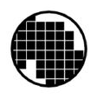
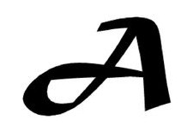
Binary images
1 | 1 | 1 | 1 | 1 | 1 | 1 | 1 | 1 | 1
1 | 1 | 1 | 0 | 1 | 1 | 1 | 1 | 1 | 1
1 | 1 | 0 | 0 | 0 | 0 | 0 | 0 | 1 | 1
1 | 0 | 0 | 0 | 0 | 0 | 0 | 0 | 0 | 1
1 | 0 | 0 | 0 | 0 | 0 | 0 | 0 | 0 | 1
1 | 0 | 0 | 1 | 0 | 0 | 0 | 0 | 0 | 0
1 | 1 | 1 | 1 | 0 | 0 | 0 | 0 | 0 | 1
1 | 1 | 1 | 1 | 1 | 0 | 0 | 1 | 1 | 1

Slide 27
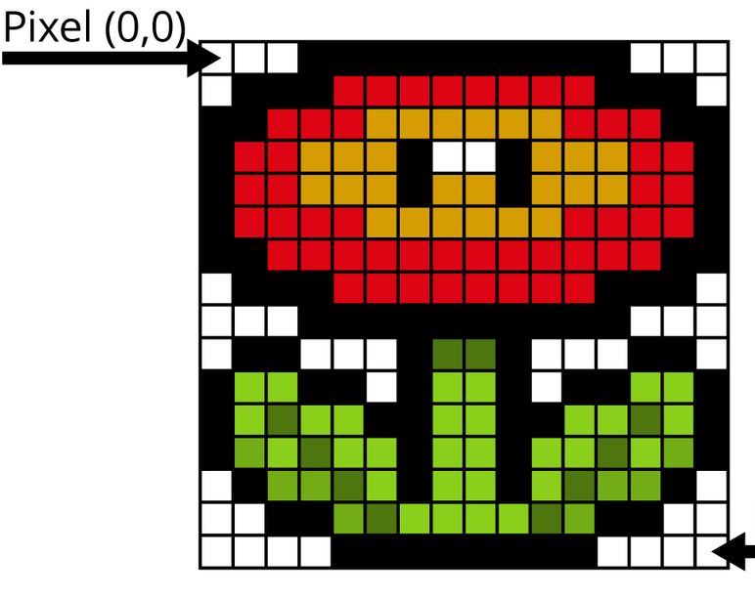
Color images
(FF,FF,FF) | (FF,FF,FF) | (0,0,0) | (0,0,0) | (0,0,0) | (0,0,0)
(FF,FF,FF) | (0,0,0) | (0,0,0) | (0,0,0) | (FF,0,0) | (FF,0,0)
(0,0,0) | (0,0,0) | (FF,0,0) | (FF,0,0) | (FF,0,0) | (FF,FF,0)
(0,0,0) | (FF,0,0) | (FF,0,0) | (FF,FF,0) | (FF,FF,0) | (FF,FF,0)
(0,0,0) | (FF,0,0) | (FF,0,0) | (FF,FF,0) | (FF,FF,0) | (FF,FF,0)

Slide 28
Q & A
Notes:
In Slide Show mode, click the arrow to enter the PowerPoint Getting Started Center.

